Slide 1
Recipe Rendezvous
Caitlin Yau, Jordyn Young, Kaitlin Kaii
Notes:
Caitlin
.

Slide 2
Agenda
Our Project
What is it?, Target Audience, Goals, Our Inspiration, Areas of Focus
Our Timeline
Our main steps towards completion
Mockup and IA
Our website application mockup and information architecture
Conclusion
Closing thoughts after completion of the project.
Notes:
Caitlin

Slide 3
Our Project
What is our project?
Notes:
Caitlin - Transition to Jordyn

Slide 4
Our Project
What is it?
Target Audience
Goals
Our web application is a random recipe generator where users can select a meal and a recipe will be generated.
Our target audience is any cook, whether new to cooking or not, in need of a recipe.
To attend to the needs of users who want to create fun, new recipes they have not seen before
Cater to user’s meal preferences
Create a user friendly website to allow cooking lovers to cook with varying recipes
Our inspiration
Areas of Focus
Kaitlin loves cooking :)
An HTML/CSS/JS based app using jQuery to parse JSON files filled with recipes.
Notes:
Jordyn

Slide 5
Our Timeline
Our main steps towards completion
Notes:
Jordyn

Slide 6
Our Timeline
01
02
03
04
Created Proposal and IA
Created our whole project idea, structure, and name.
Created Plan and Website
Created our project plan and mock up.
Finished Plan and Website
Updated plan so it’s more doable and finished website.
Presentation Time!
Styled our website and created our presentation.
Notes:
Jordyn - Transition to Kaitlin

Slide 7
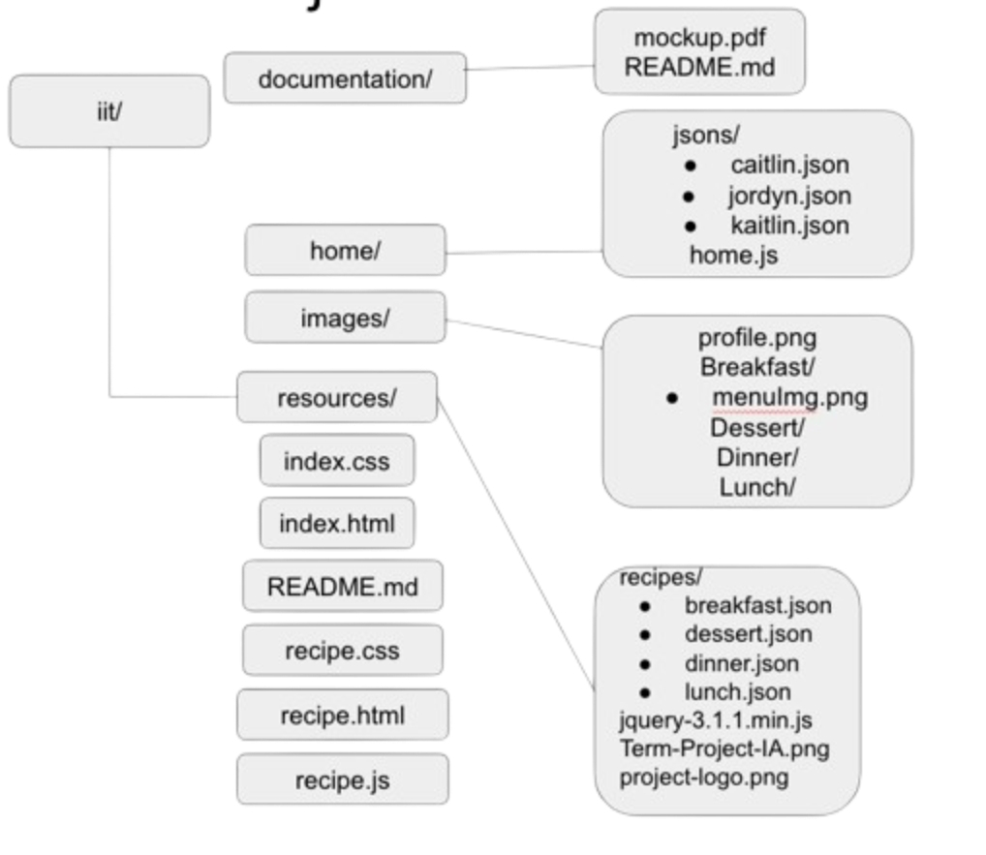
Our Information Architecture
Homepage Data
root folder
Recipe Images
-JSON files
Libraries
Notes:
Kaitlin
Here is our file structure visualized by the IA. It started off small but eventually we created more data files and folders to sort them. In our root folder we have our main page files along with folders for our documentation and resources.

Slide 8
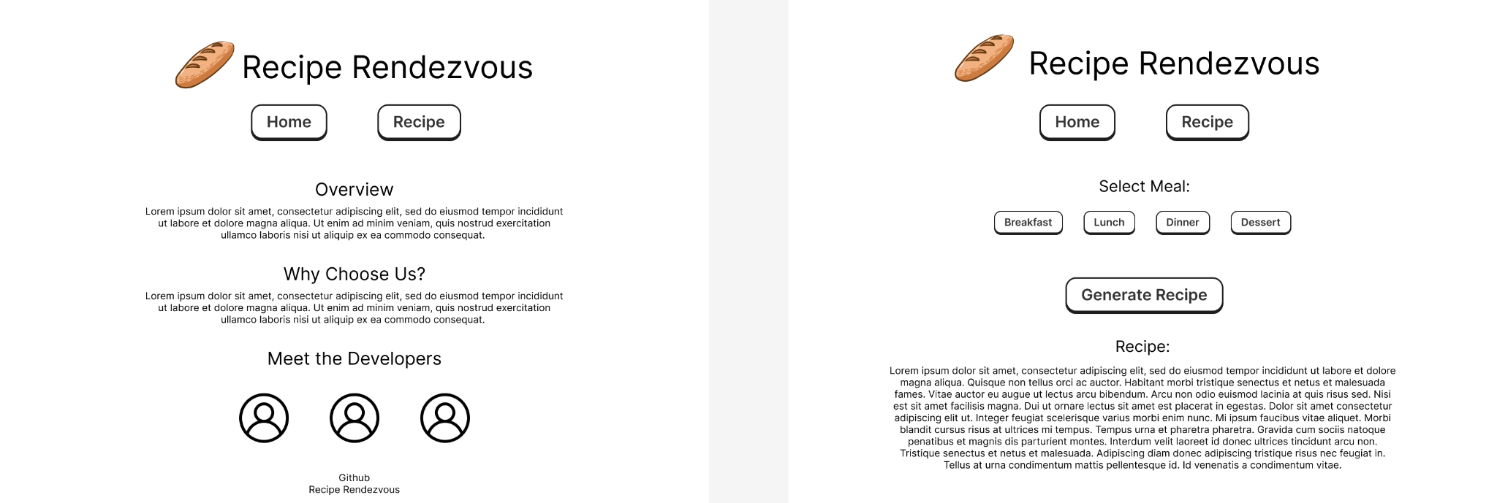
Our Mockup
Notes:
Kaitlin
We designed two main pages. Our homepage provides information about our project and the developers. The recipes page is where users will provide inputs and generate random recipes.

Slide 9
Personas
Wendy-
A gourmet chef who is looking for recipes to serve at her restaurant. She wants to create and serve high quality food and is out of ideas. She would utilize Recipe Rendezvous in order to create new, unique meals that offer variety across her menu.
Bob-
A junior college student who currently has a low paying job and no free time due to always attending classes and studying hard. He has to take care of himself and so he needs to balance his time cooking meals, doing laundry, running errands, cleaning, etc. He often finds that he doesn’t have enough time to do all these things in a comfortable, timely manner and just wants to be able to cook for himself without always having to waste more and more money on groceries and constantly look for different recipes to try. He just wants a simple way to find new recipes to try.
Dorothy Morris-
A single mother of two who is limited by a low budget. She was never formally taught how to cook so she doesn’t feel confident about where to start and feels that her current cooking habits could be improved. She is always struggling to figure out how to integrate healthier ingredients into her children’s diets as they are picky eaters as well. After discovering this app, she was able to be more creative with her dishes and learned a lot of new cooking tips.
Notes:
Kaitlin
We created personas of potential users that would use our project. We have:
Wendy, a chef looking for new recipes. As a chef Wendy can utilize Recipe Rendezvous to create new, unique meals for her menu
Bob, a college student who is on a low budget and can explore potential options using Recipe Rendevous
Dorothy, a mother who is trying to diversify her children’s diets and can use RECEIPE RENDEvous to be more creative with her dishes

Slide 10
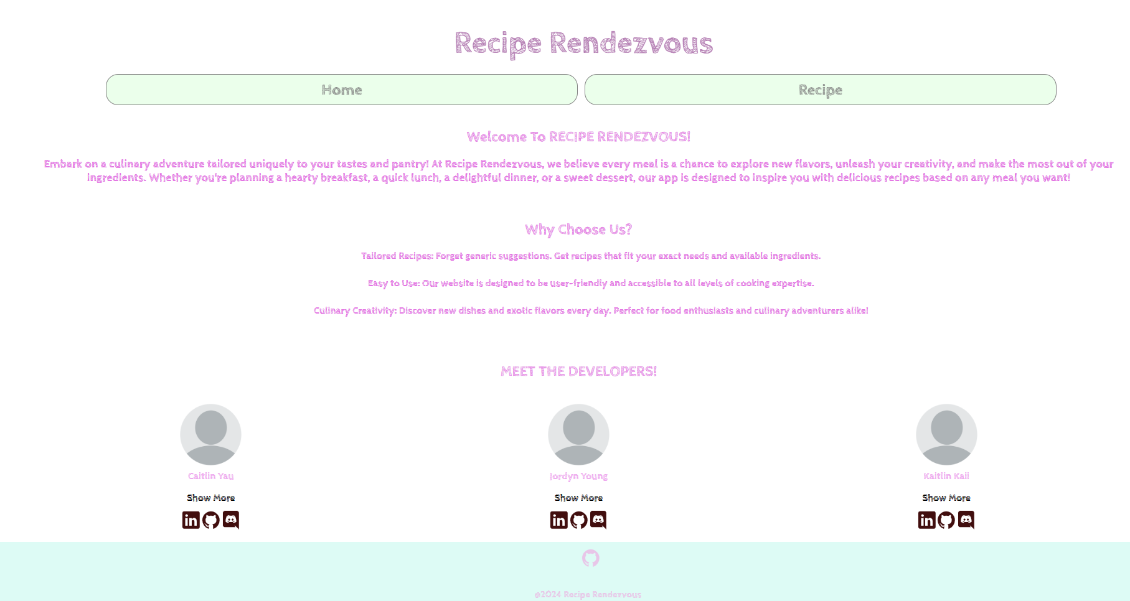
Let’s Take a Look At Our Project!
Notes:
Kaitlin - Transition to Caitlin
showcase proj

Slide 11
Deeper Analysis
Notes:
Caitlin - transition to Jordyn

Slide 12
HTML and CSS
HTML and CSS Transitions
HTML, CSS, jQuery
Notes:
Jordyn - Transition to Caitlin

Slide 13
HTML/CSS
<header> <button>
Notes:
Caitlin

Slide 14
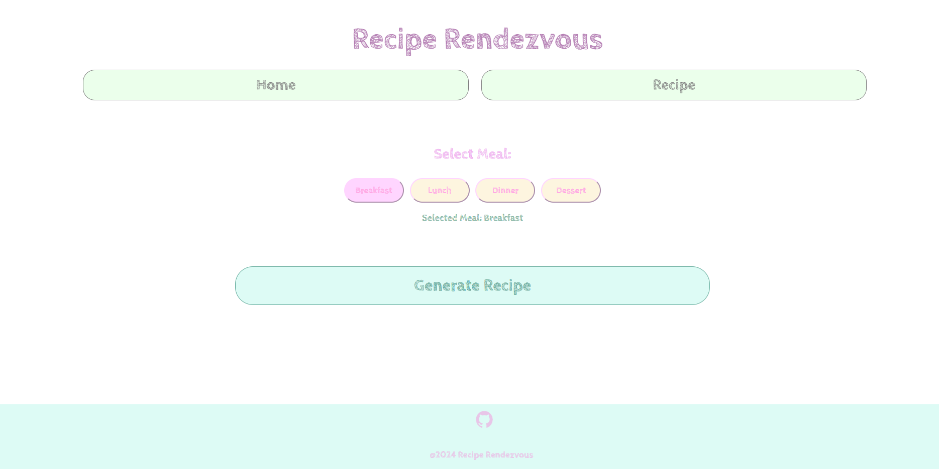
HTML/CSS/
Javascript
<button>
HTML/CSS
<button>
Notes:
Caitlin - Transition to Kaitlin

Slide 15
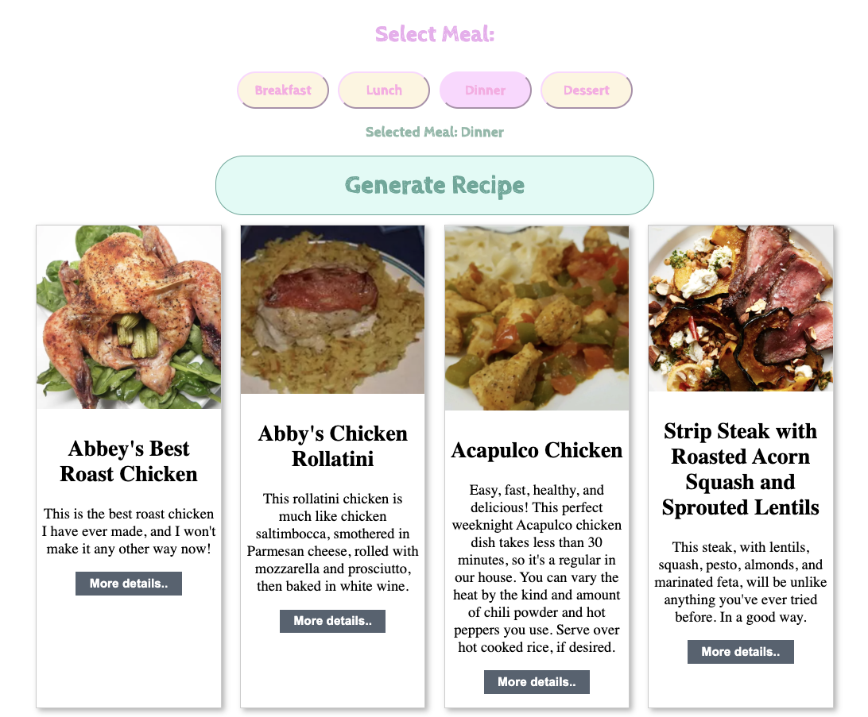
Gallery Layout
Recipe Cards
Notes:
Kaitlin
The functionality I implemented into our recipe page is a gallery of cards that provide a quick overview of each recipe. Users can scroll through the recipes they generated from their inputs and choose what meal to have for the day.
I sourced recipes from a database online (recipes.com) and stored it into a set of JSON files in our repository. I pulled the data onto our page using AJAX and while doing so, I would randomly pick recipes within that meal type to display, as you continuously click generate recipe the recipes along with the number of recipes generated. I kept track of recipes in an array so that duplicates wouldn’t occur during generation.

Slide 16
Challenges and How We Solved Them
Challenges
Solutions
Our initial idea for our project was too complex to be completed in the time we were given.
We decided to make an easier program and move the rest of our ideas to our future plans for this project.
There were multiple components such as icons and event listeners we didn’t know how to make or integrate with our website
We did lots of research on documentation for components and syntax for HTML, CSS, JSON files, and JavaScript
Building our JSON files and creating a selector for user inputs to display recipe options for users. Tailoring it to the user request and preferences.
I used online references to implement this functionality as well as accounts from individuals to see what users would actually want.
Notes:
Kaitlin - Transition to Caitlin
The initial idea for our project was too complex to be completed in the time we were given. Solution: we decided to make an easier program and move the rest of our ideas to our future plans for this project
There were multiple components such as icons and event listeners that we didnt know how to integrate or make solution we did research on documentation for these components and syntax for HTML, CSS, and javascript
Choosing a database to derive recipes from and building JSON files to display them on our page. SOLTION i found a popular by reading through accounts and reviews database of simple recipes and used online references to incorporate it into our website and

Slide 17
Future Plans
Improved User Interface (UI):
Enhance the overall design with modern UI elements, such as animations, transitions, and responsive layouts.
Enhanced Recipe Selection:
Allow users to specify dietary preferences, such as vegetarian, vegan, gluten-free, or keto-friendly recipes, to cater to diverse dietary needs.
Ingredient Filtering and Substitution:
Incorporate functionality to filter recipes based on available ingredients, allowing users to input ingredients they have on hand and receive tailored recipe suggestions. Additionally, provide suggestions for ingredient substitutions to accommodate users who may not have certain ingredients readily available.
Notes:
Caitlin - Transition to Jordyn

Slide 18
Future Plans (Cont.)
User Accounts and Personalization:
Implement user accounts to allow users to save favorite recipes, create shopping lists, and track their cooking history.
Social Sharing and Community Features:
Foster a sense of community by allowing users to rate and review recipes, share cooking tips, and participate in discussion forums or cooking challenges.
Integration with Other Devices:
Regularly test the website across various browsers, devices, and screen sizes to identify and address any compatibility issues or usability concerns.
Notes:
Jordyn

Slide 19
Questions?
Notes:
Jordyn

Slide 20
References
Our recipes were sourced from this database of recipes and sorted to suit what we needed for this project
https://github.com/dpapathanasiou/recipes
To learn jQuery, HTML, and CSS styling for our webpage:
https://www.geeksforgeeks.org/
https://stackoverflow.com/
https://fonts.google.com/ https://coder-coder.com/how-to-center-button-with-html-css/#:~:text=You%20can%20achieve%20this%20by,center%20them%20on%20the%20page
https://www.w3schools.com/css/css3_buttons.asp
Notes:
Jordyn

